Slide 1
How to get a boyfriend?
——hk_shao

Slide 2
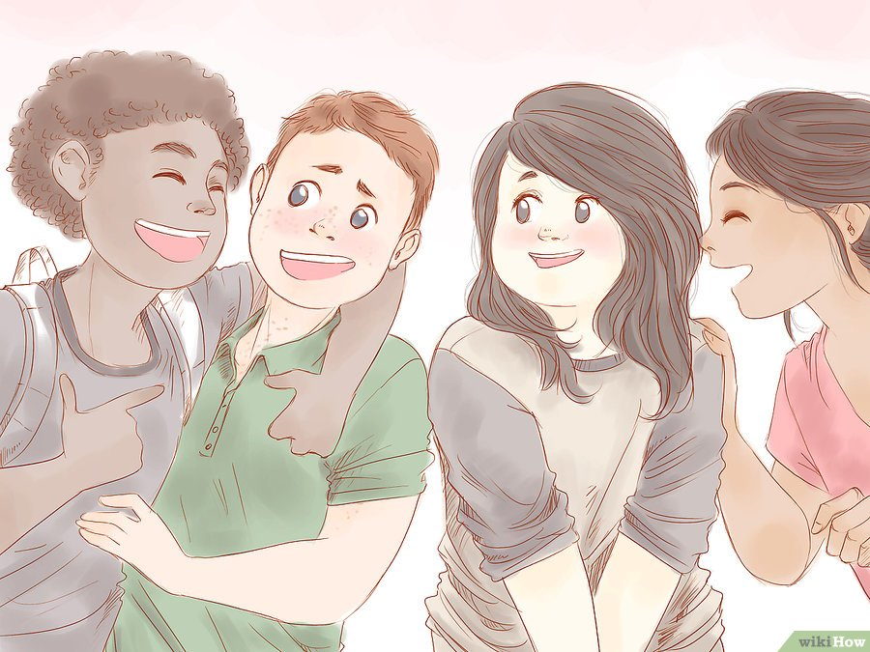
Looking for Great Guys

Slide 3
Looking for Great Guys
Like me.

Slide 4
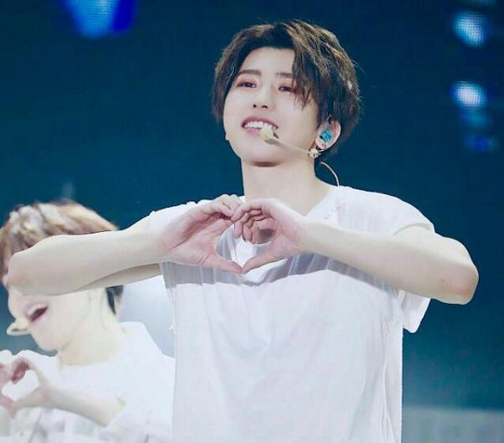
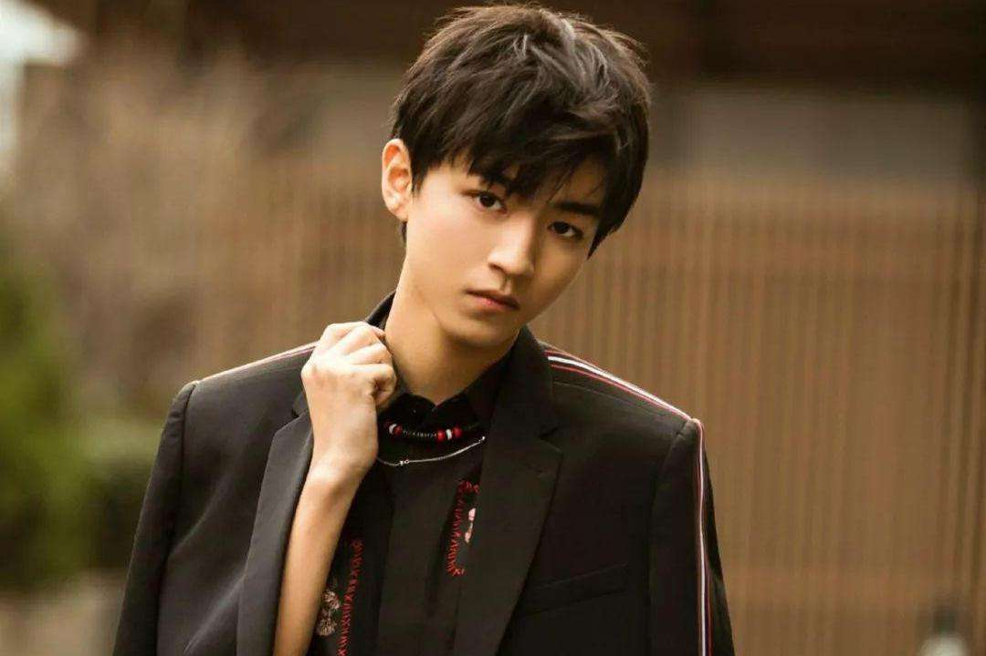
Cai Xukun
Wang Junkai

Slide 5
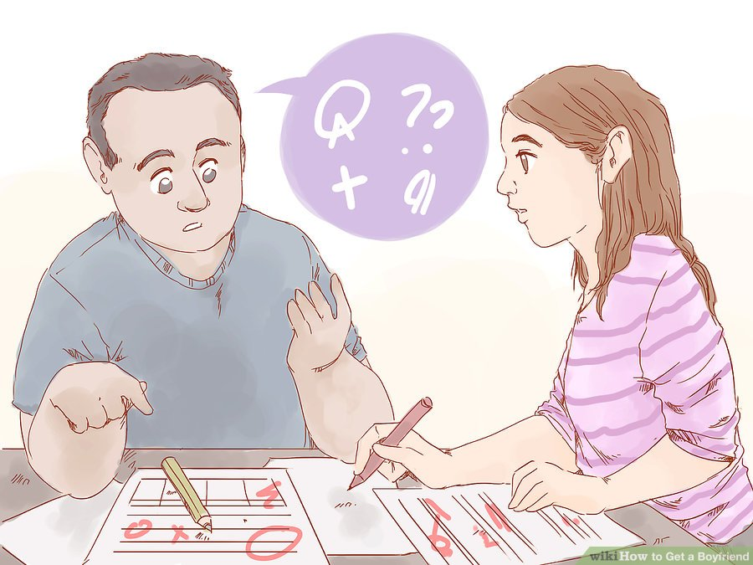
Will he teach you how to do math exercies?

Slide 6
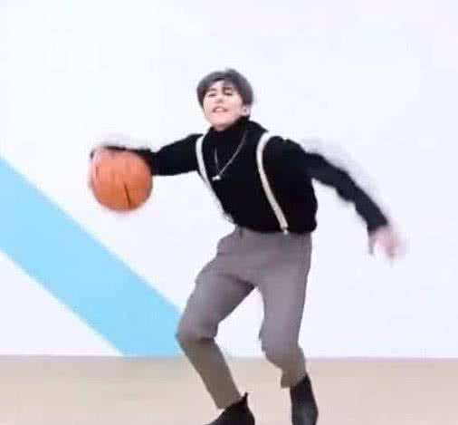
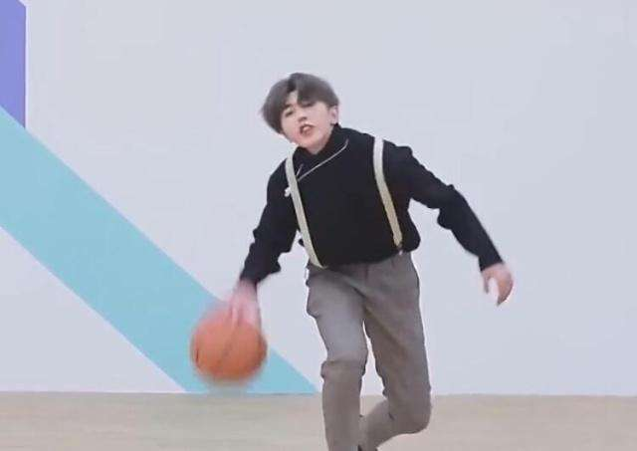
Can he play
basketball well?

Slide 7
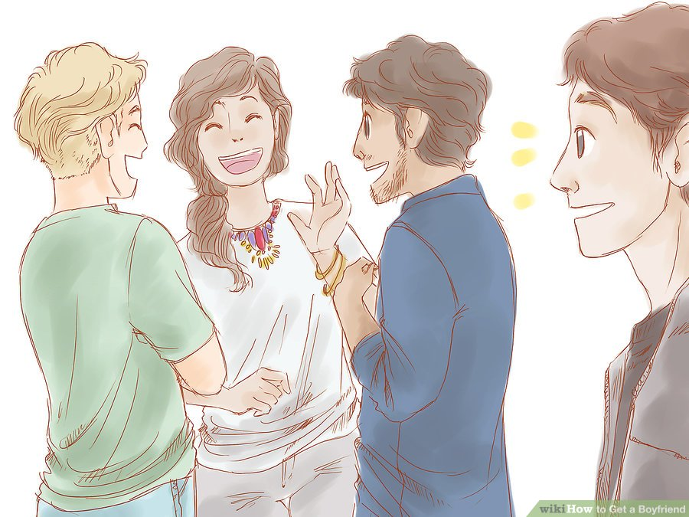
Developing Your Friendship

Slide 8
Developing Your Friendship
No way! You will be caught by Liu Shan and go home to reflect.

Slide 9
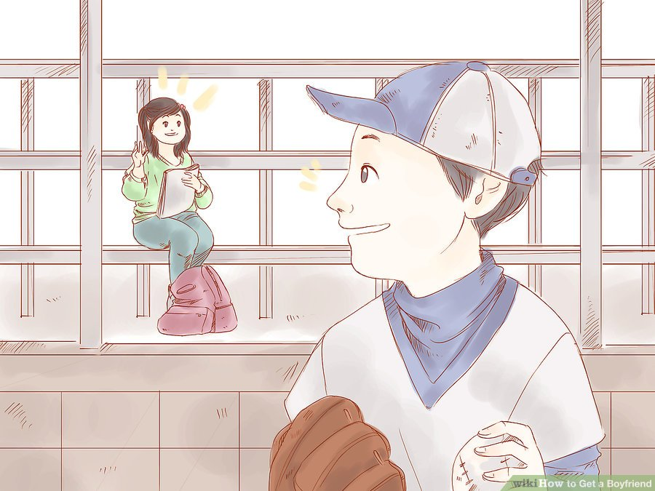
Making Him Fall for You

Slide 10
Making Him Fall for You
No way! You are ugly and fierce like a tiger. No boy will fall in love with you.

Slide 11
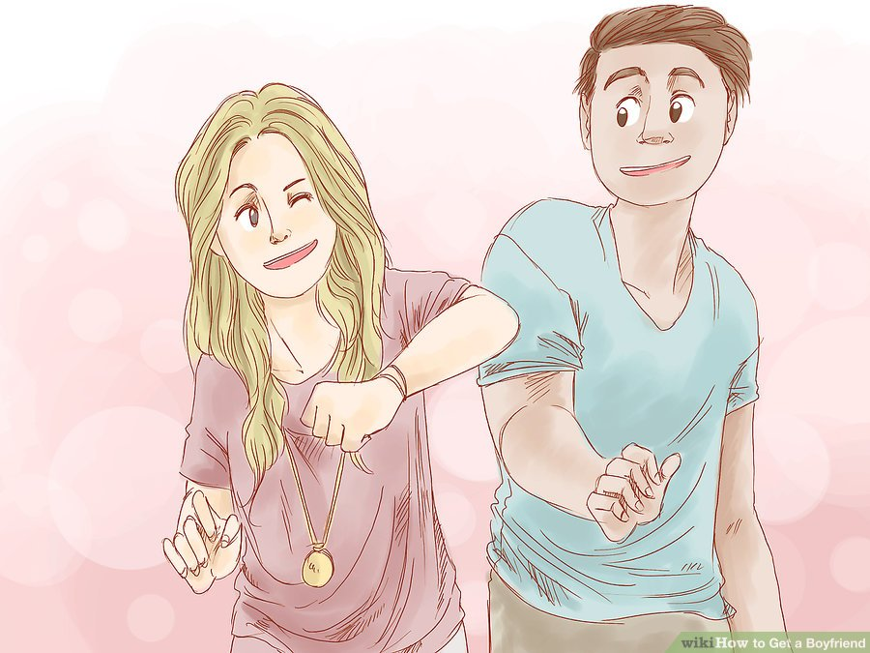
Making a Move

Slide 12
Making a Move
No way! Liu Shan is coming!

Slide 13
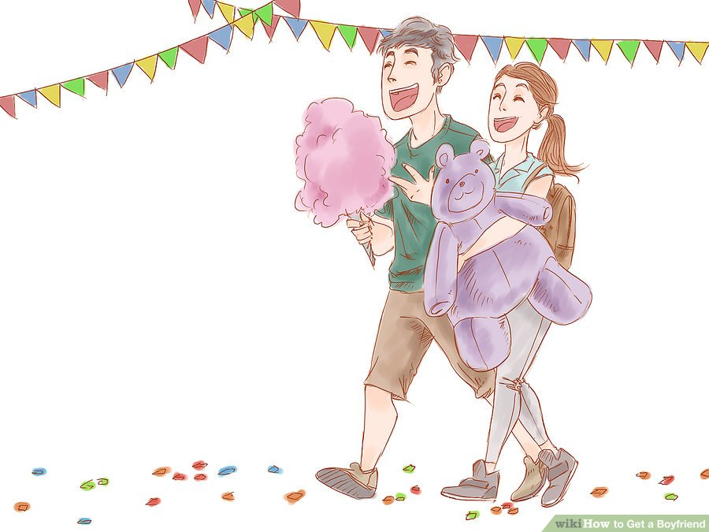
Making Connections in the
Future

Slide 14
Making Connections in the
Future
Oh, My God! How many babies do you want to have?

Slide 15
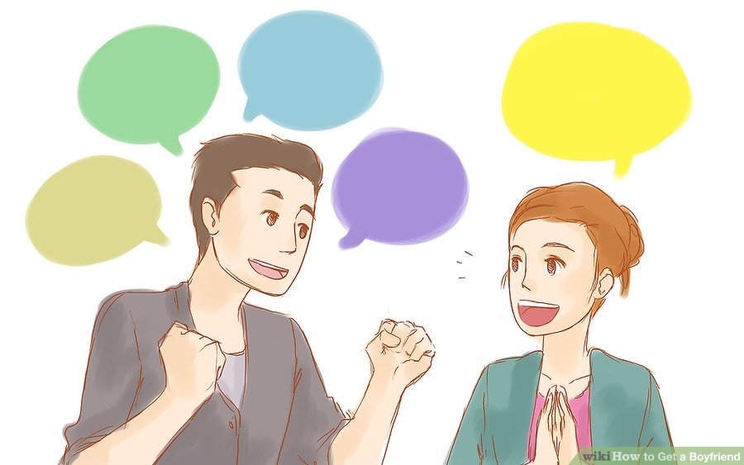
The end.

Slide 16
Today I want to talk about how to get a boyfriend. If any boy is here also wants to get a boyfriend, you can come and listen to my speech too. But if you are gay, I can understand. In addition, for those beautiful girls who already have a boyfriend, I can teach you have more boyfriends. Okay, let's get to the point!First of all, you need to meet a boy. I know you all want to meet a handsome, funny, smart and kind boy. Cai Xukun or Wang Junkai? No, don't daydream! It's your desire, not your dream. You need to have a dream. Like me. I'm your dream, right? A very nice boy. If you want to have a boy friend like that, even though it's your pleasure, please don't disturb me. But you say you love the ClassGrass (Not the grass in the class, but the most handsome boy in the class) in the class next door. It doesn't matter for me. Beacuse if I were your father, I would say "Daughter! You've finally grown up, like a woman!"Okay, let's speed up a little bit. After you find the right person, get to know him a bit. For example, how is his academic performances? Will he teach you how to do math exercies? Does he have a lot of money at home? Can he play basketball well? It should be noted here that you don't need to know that Cai Xukun can play basketball well. Developing Your Friendship. No way. You will be caught by Liu Shan and go home to reflect.Making Him Fall for You. No way. You are ugly and fierce like a tiger. No boy will fall in love with you. Making a Move. No way. Liu Shan is coming! Making Connections in the Future. Oh, My God! How many babies do you want to have? Okay, that's all I have to say. If you have any questions, you can ask me now. No? Thank you, my speech is over.
今天我想谈谈如何交男朋友。如果这里有男孩也想找男朋友，你也可以来听我的演讲。但如果你是同性恋，我可以理解。另外，对于那些已经有男朋友的漂亮女孩，我可以教你有更多的男朋友。好吧，我们直说吧！
首先，你需要认识一个男孩。我知道你们都想见一个英俊，有趣，聪明和善良的男孩。蔡旭坤还是王俊凯？不，别做白日梦！这是你的愿望，不是你的梦想。你需要有一个梦想。像我一样。我是你的梦，对吧？一个非常好的男孩。如果你想有这样的男朋友，尽管这是你的荣幸，请不要打扰我。但你说你爱隔壁班的小草（不是班上的小草，而是班上最帅的男孩）。对我来说没关系。因为如果我是你父亲，我会说“女儿！你终于长大了，像个女人！”
好吧，让我们加快一点。找到合适的人后，再了解他一点。例如，他的学习成绩如何？他会教你怎么做数学练习吗？他家里有很多钱吗？他篮球打得好吗？这里要注意的是，你不需要知道蔡旭坤篮球打得很好。
发展你的友谊。不可能。你会被刘山抓到回家反省。
让他爱上你。不可能。你像老虎一样又丑又凶。没有男孩会爱上你。
行动起来。不可能。刘山来了！
在未来建立联系。哦，天哪！你想生几个孩子？
好吧，这就是我要说的。如果你有什么问题，现在可以问我。没有？谢谢大家，我的演讲结束了。

Slide 17

Thanks
https://www.wikihow.com/Get-a-Boyfriend

